Slide 1

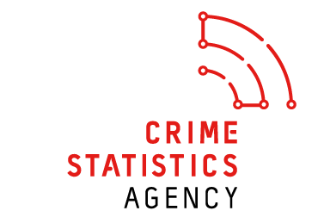
Department of Justice and Community Safety (DJCS)
Author: BIAnalyticsVentures
DJCS-Version:1.0
Date: Sep 27, 2021

Slide 2
Executive Summary
Department of Justice and Community Safety
Slide1
Overall Statistics & Insights
Slide2
Offence Statistics & Insights
Slide3
Time Intelligence Insights
Step4
Summary

Slide 3
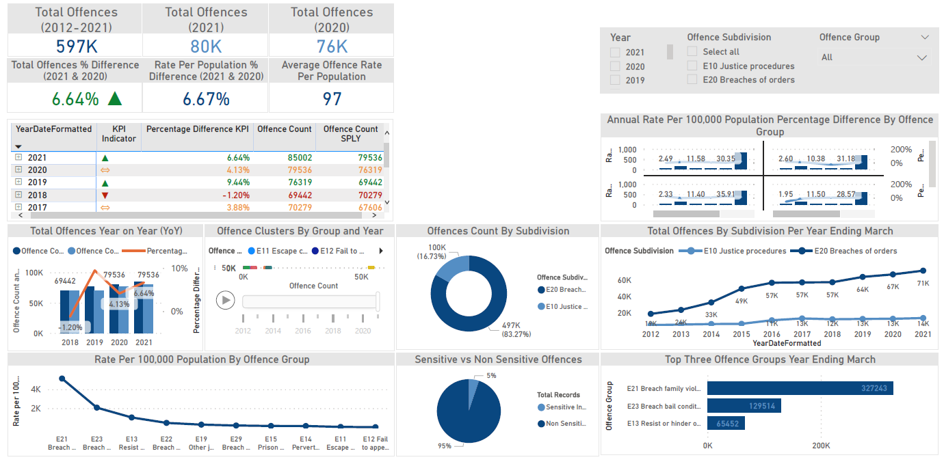
Slide 1: Overall Statistics & Insights
Department of Justice and Community Safety
E Justice Procedures Offences
Notes: Data source Crime Statistics Agency.
In order to maintain confidentiality, sensitive offence counts with a value of 1 to 3 are displayed as "≤ 3" and are given a value of 2 to calculate totals.
Recorded crime statistics are based on data extracted by Victoria police on the 18th day after the reference period, and are subject to movement between releases. Year ending month is March.
*SPLY = Same Period Last Year

Slide 4
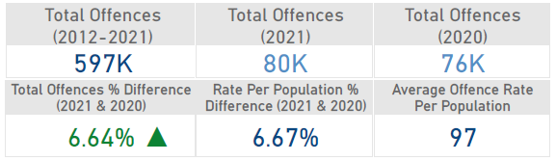
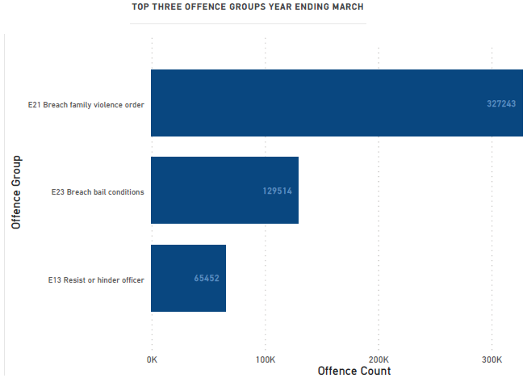
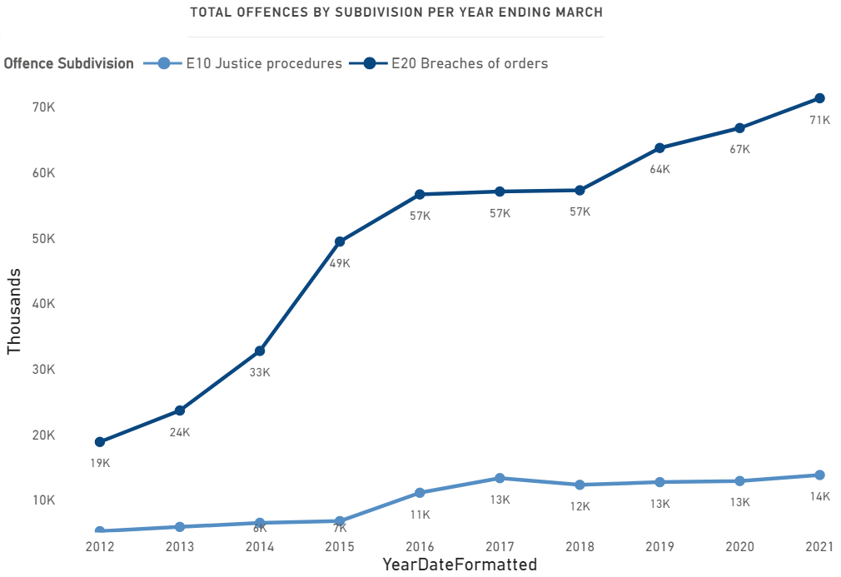
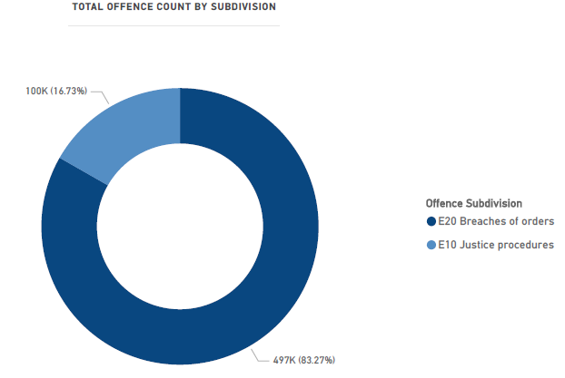
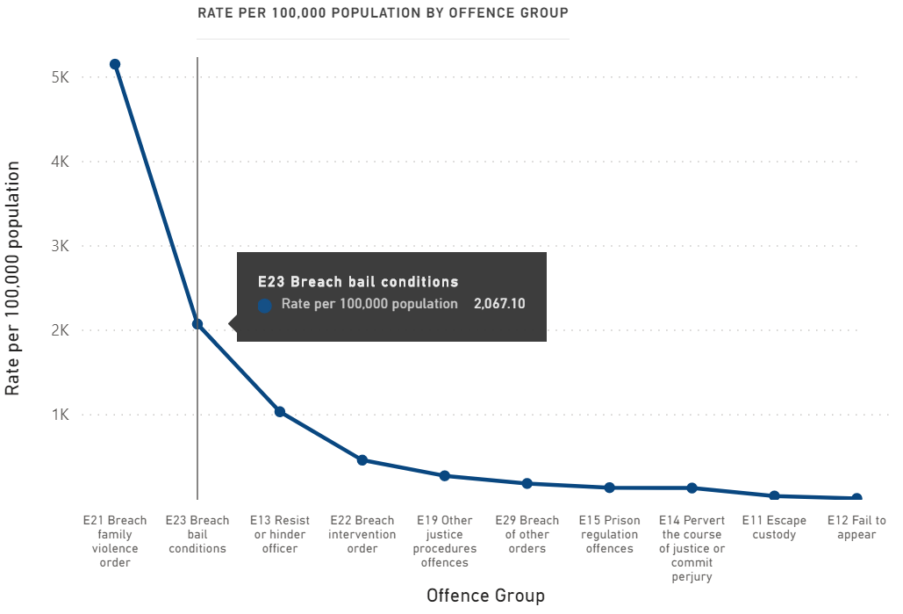
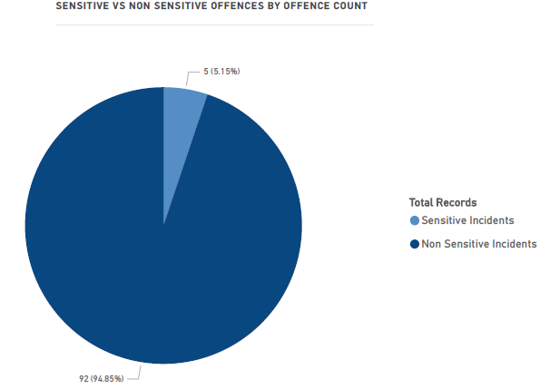
Slide 2: Offence Statistics & Insights
Department of Justice and Community Safety
E Justice Procedures Offences

Slide 5
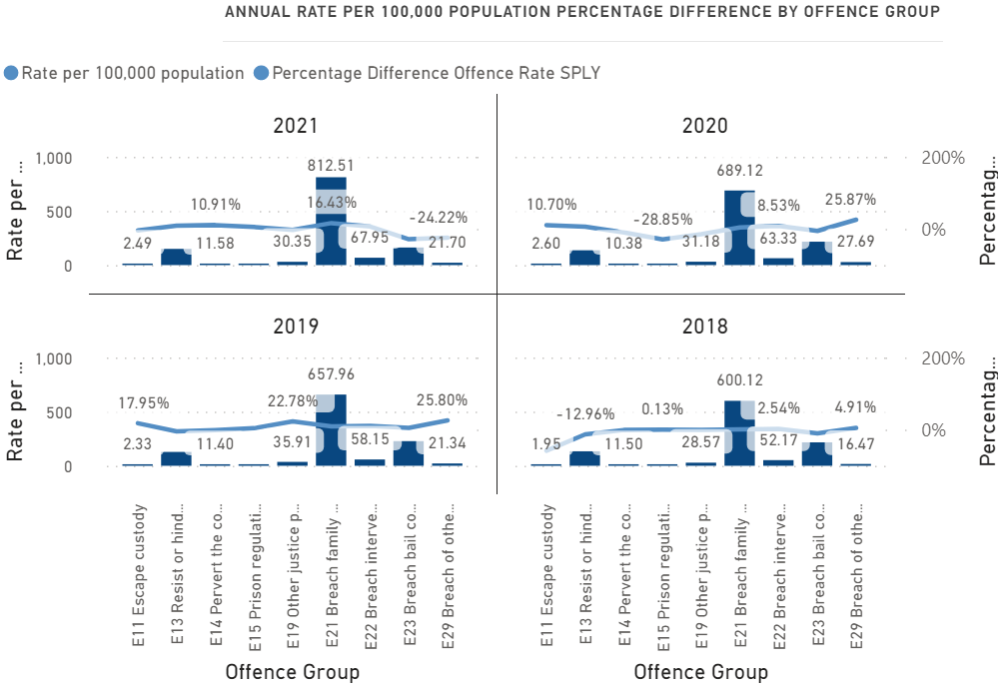
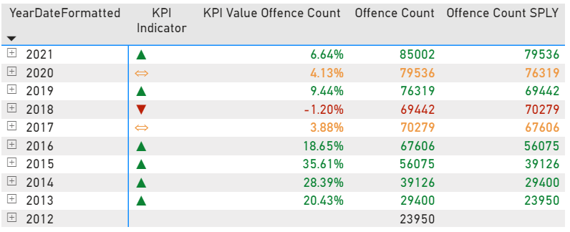
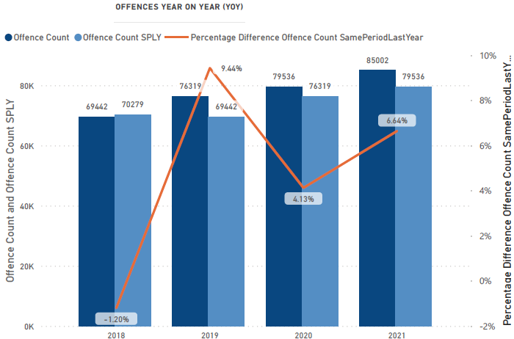
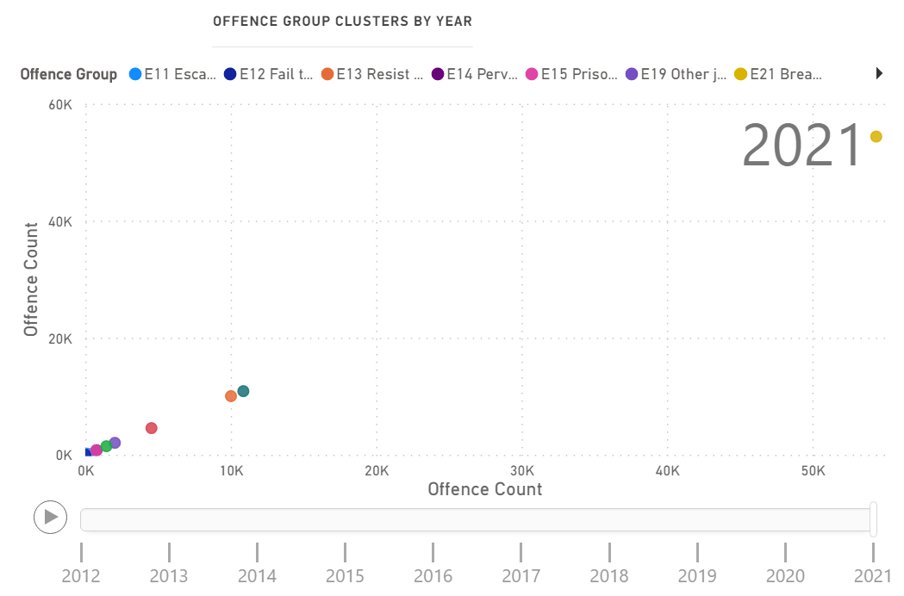
Slide 3: Time Intelligence Insights
Department of Justice and Community Safety
E Justice Procedures Offences
KPI - * More than 5% shows significant increase indicating an upwards trend in green, and more than 1% shows significant decrease indicating a downward trend in red, whereas orange signifies a less than significant threshold.

